Slide 1
CHAPTER 10: DESIGN A NOTIFICATION SYSTEM
2024-03-12

Slide 2
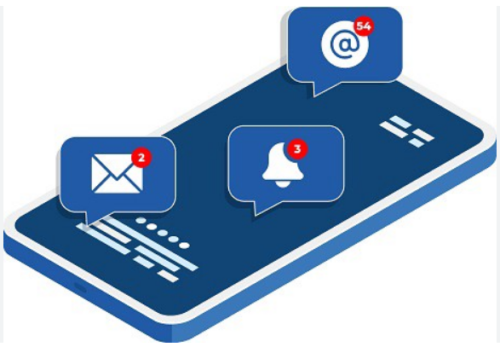
Step 0 – Introduction
A notification is more than just mobile push notification.
Three types of notification formats are:
mobile push notification
SMS message
Email.

Slide 3
Step 1 - Understand the problem and establish design scope
Candidate: What types of notifications does the system support?
Interviewer: Push notification, SMS message, and email.
Candidate: Is it a real-time system?
Interviewer: Let us say it is a soft real-time system. We want a user to receive notifications as soon as possible. However, if the system is under a high workload, a slight delay is acceptable.
Candidate: What are the supported devices?
Interviewer: iOS devices, android devices, and laptop/desktop.
Candidate: What triggers notifications?
Interviewer: Notifications can be triggered by client applications. They can also be scheduled on the server-side.
Candidate: Will users be able to opt-out?
Interviewer: Yes, users who choose to opt-out will no longer receive notifications.
Candidate: How many notifications are sent out each day?
Interviewer: 10 million mobile push notifications, 1 million SMS messages, and 5 million emails.
Supported Notification Types: The system supports push notifications, SMS messages, and emails.
System Performance Requirements: The system is a soft real-time system, where users should receive notifications as quickly as possible, but a slight delay is permissible under high load conditions.
Supported Devices: iOS devices, Android devices, laptops/desktops are supported.
Notification Triggers: Notifications can be triggered by client applications and can also be scheduled on the server side.
User Opt-out Option: Users can opt out of receiving notifications selectively.
Daily Notification Volume: The system sends 10 million mobile push notifications, 1 million SMS messages, and 5 million emails daily.

Slide 4
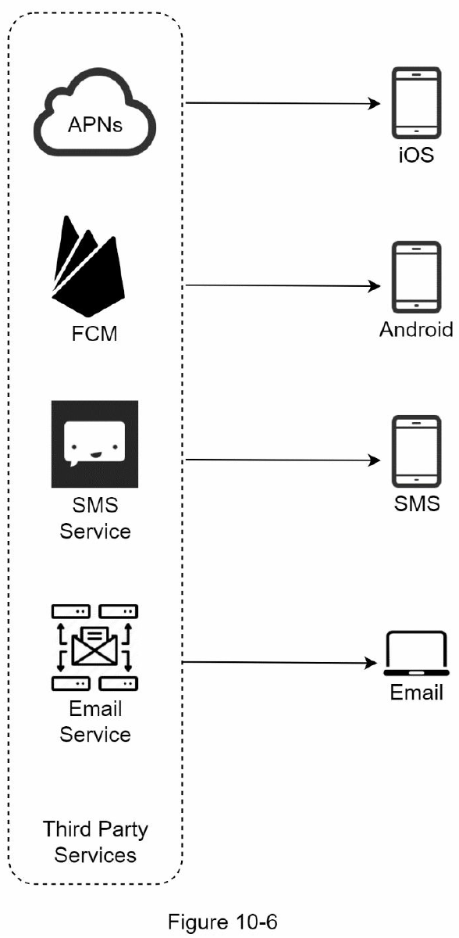
Step 2 - Propose high-level design and get buy-in
Different types of notifications
iOS push notification
Apple Push Notification Service (APNS)
Android push notification
Firebase Cloud Messaging (FCM)
SMS message
Twillo, Nexmo
Email
Sendgrid, Mailchimp

Slide 5
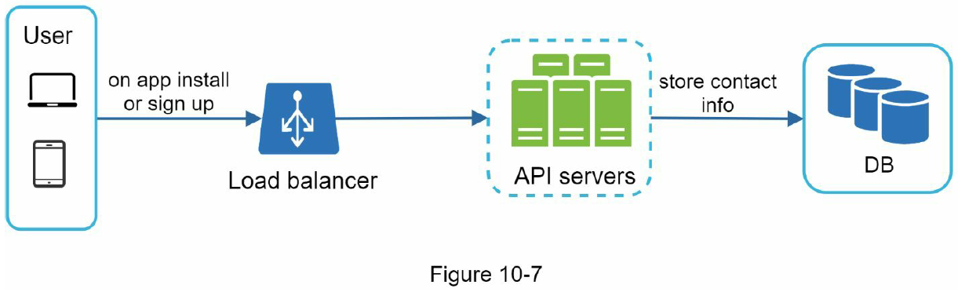
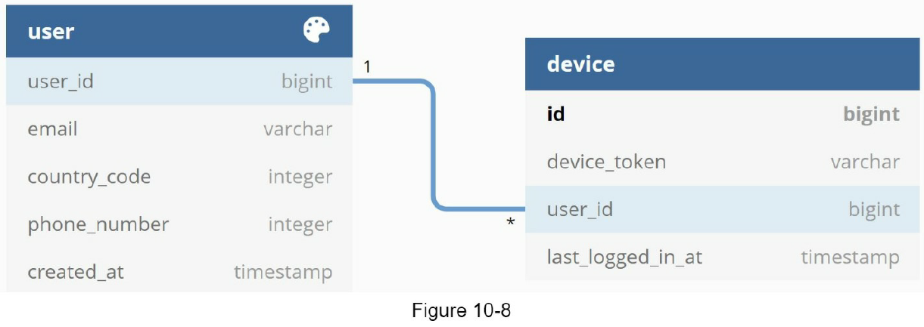
Step 2 - Propose high-level design and get buy-in
Contact info gathering flow
To send notifications, we need to gather mobile device tokens, phone numbers, or email addresses.
When a user installs our app or signs up for the first time, API servers collect user contact info and store it in the database.
Mobile device tokens are unique identifiers generated by push notification services (e.g., APNs, FCM) for identifying mobile devices.
They are used by servers to send push notifications to specific devices. Each device has its own unique token, which can change when the app is installed or updated. Therefore, apps must regularly update the token on the server to ensure successful notification delivery.
Email addresses and phone numbers are stored in the user table, whereas device tokens are stored in the deice table. A user can have multiple devices, indicating that a push notification can be sent to all the user devices.

Slide 6
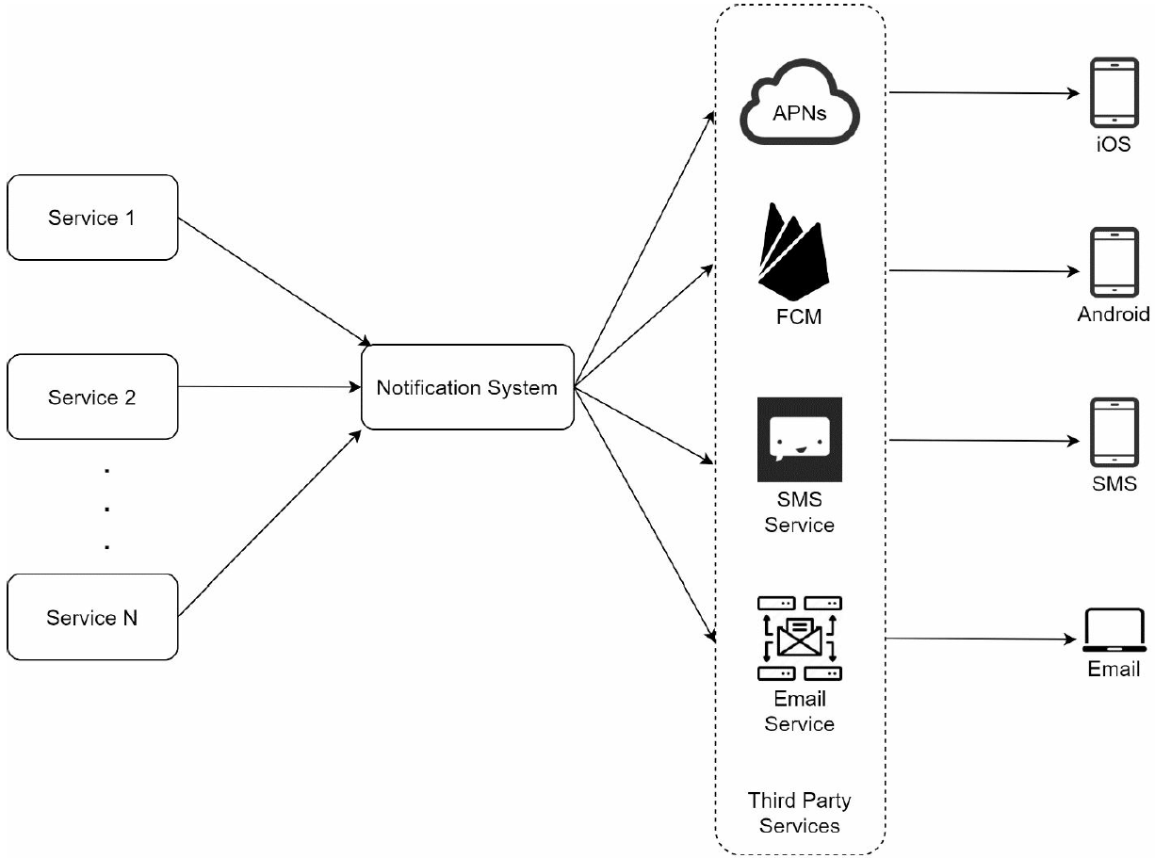
Step 2 - Propose high-level design and get buy-in
Notification sending/receiving flow
Service 1 to N: A service can be a micro-service, a cron job, or a distributed system that triggers notification sending events.
Three problems are identified in this design
Single point of failure (SPOF): A single notification server means SPOF.
Hard to scale: The notification system handles everything related to push notifications in one server. It is challenging to scale databases, caches, and different notification processing components independently.
Performance bottleneck: Processing and sending notifications can be resource intensive. For example, constructing HTML pages and waiting for responses from third party services could take time. Handling everything in one system can result in the system overload, especially during peak hours.

Slide 7
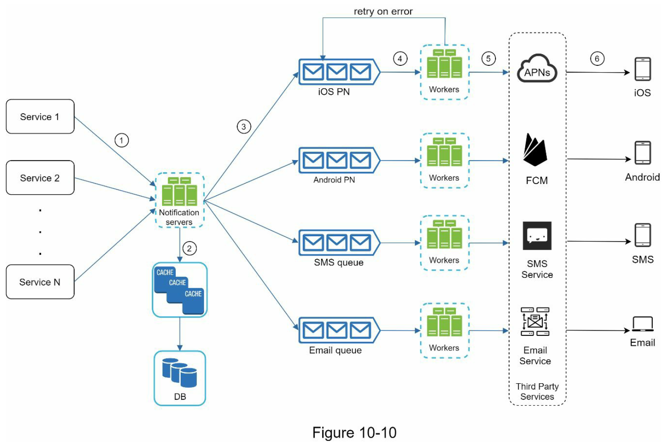
Step 2 - Propose high-level design and get buy-in
High-level design (improved)
Move the database and cache out of the notification server.
Cache: User info, device info, notification templates are cached.
DB: It stores data about user, notification, settings, etc.
Add more notification servers and set up automatic horizontal scaling.
Introduce message queues to decouple the system components.
They remove dependencies between components. Message queues serve as buffers when high volumes of notifications are to be sent out.
Each notification type is assigned with a distinct message queue so an outage in one third-party service will not affect other notification types.
Workers: Workers are a list of servers that pull notification events from message queues and send them to the corresponding third-party services.

Slide 8
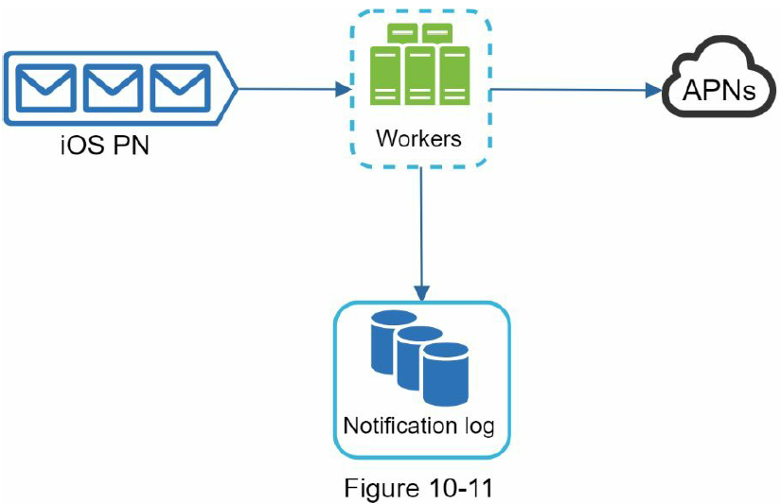
Step 3 - Design deep dive
Reliability
One of the most important requirements in a notification system is that it cannot lose data.
Notifications can usually be delayed or re-ordered, but never lost.
To satisfy this requirement, the notification system persists notification data in a database and implements a retry mechanism.
The notification log database is included for data persistence, as shown in Figure 10-11.

Slide 9
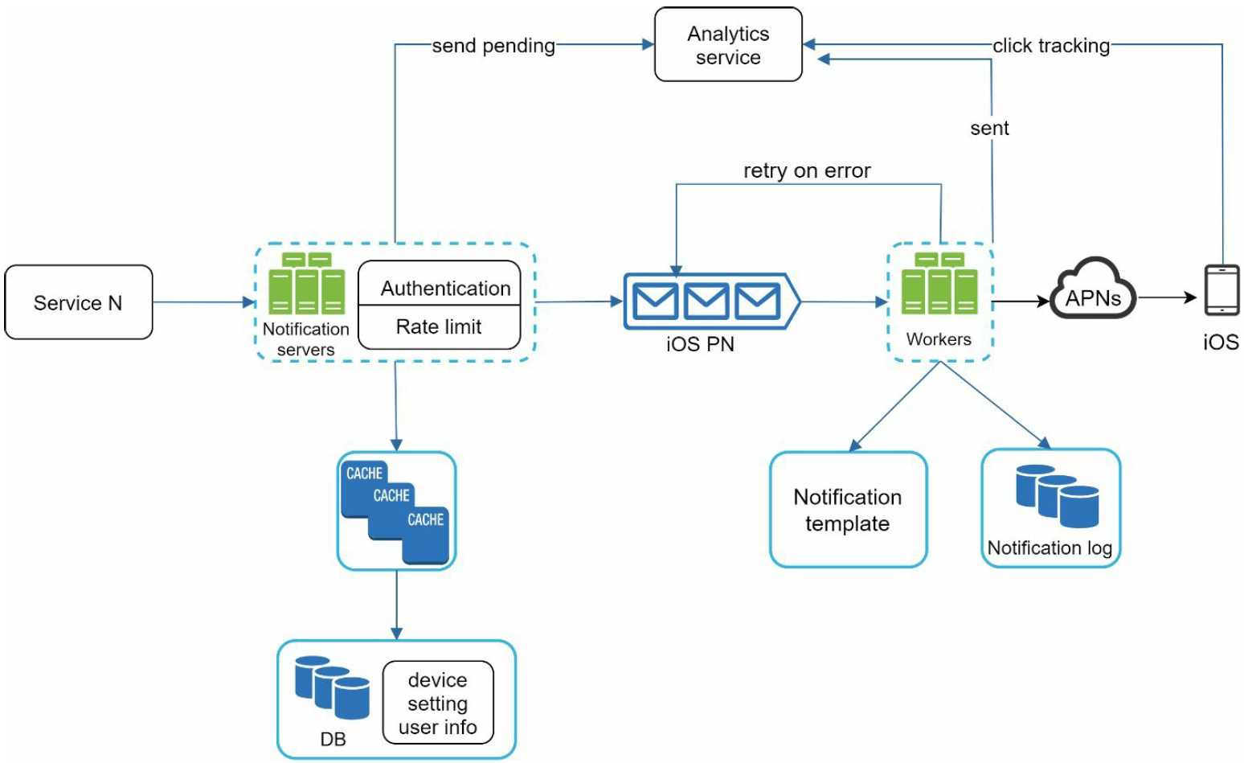
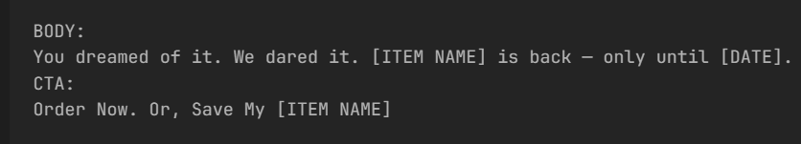
Step 3 - Design deep dive
Additional components and considerations
Notification template
Notification setting
Rate limiting
Retry mechanism
Security in push notifications
Monitor queued notifications
Events tracking

Slide 10
Step 3 - Design deep dive (appKey and appSecret)
appKey and appSecret are security mechanisms that allow an app to communicate securely with a server. They are particularly important when using push notification services.
appKey:
This is typically a unique identifier for the application that can be publicly known.
The appKey is used to identify a specific application and helps the service provider determine whether the application is authorized to receive notifications.
appSecret
The appSecret is the application's secret key, known only to the application developer,
and is used to prove that a request comes from the application when sending requests to the server.
The security process using appKey and appSecret works as follows:
App Authentication:
When sending a request to the server, the app includes the appKey.
The server uses this appKey to identify the app and verify that it is a registered app.
Request Signing:
When sending a request, the app uses the appSecret to generate a signature for the request.
This signature involves encrypting the request data using the appSecret.
Server Verification:
Upon receiving the request, the server uses the appKey to look up the corresponding appSecret
and decrypts the signature in the request using the appSecret.
If the signature matches, the request is considered valid and trustworthy and is processed accordingly.

